Slide 1



Case Study 01
More Beer?
Jeremy Dawkins
George Migot Ndede

Slide 2
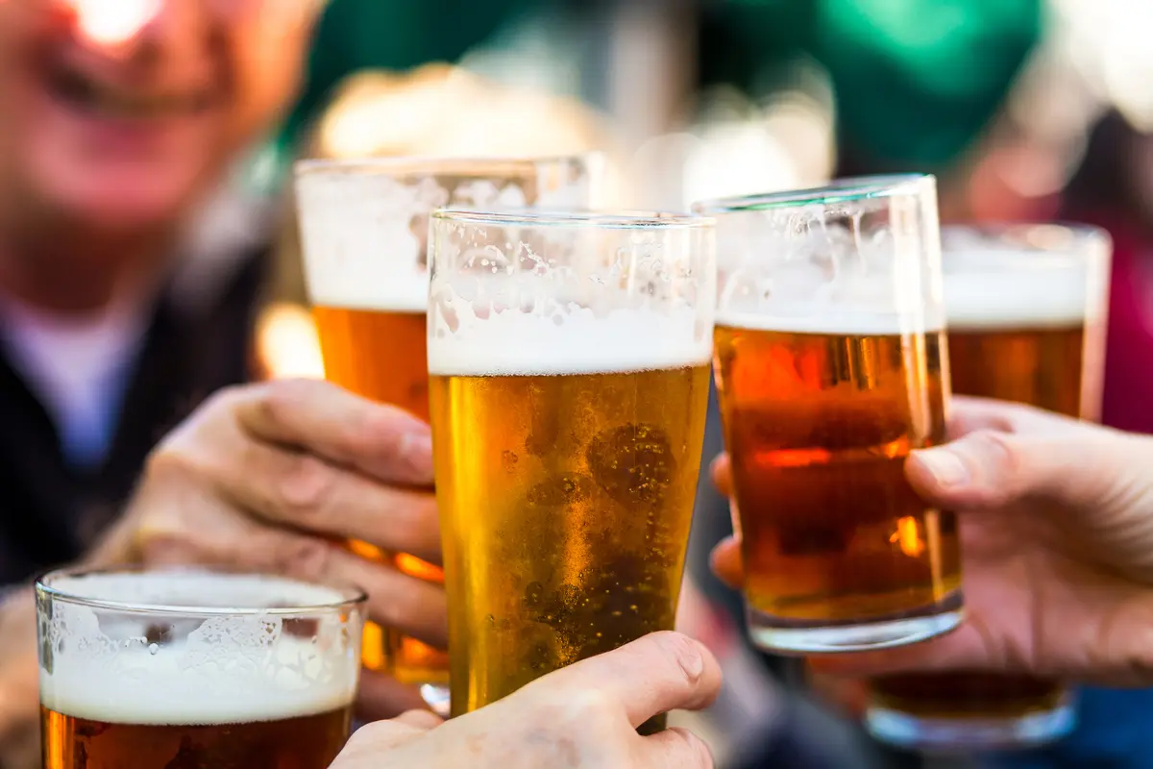
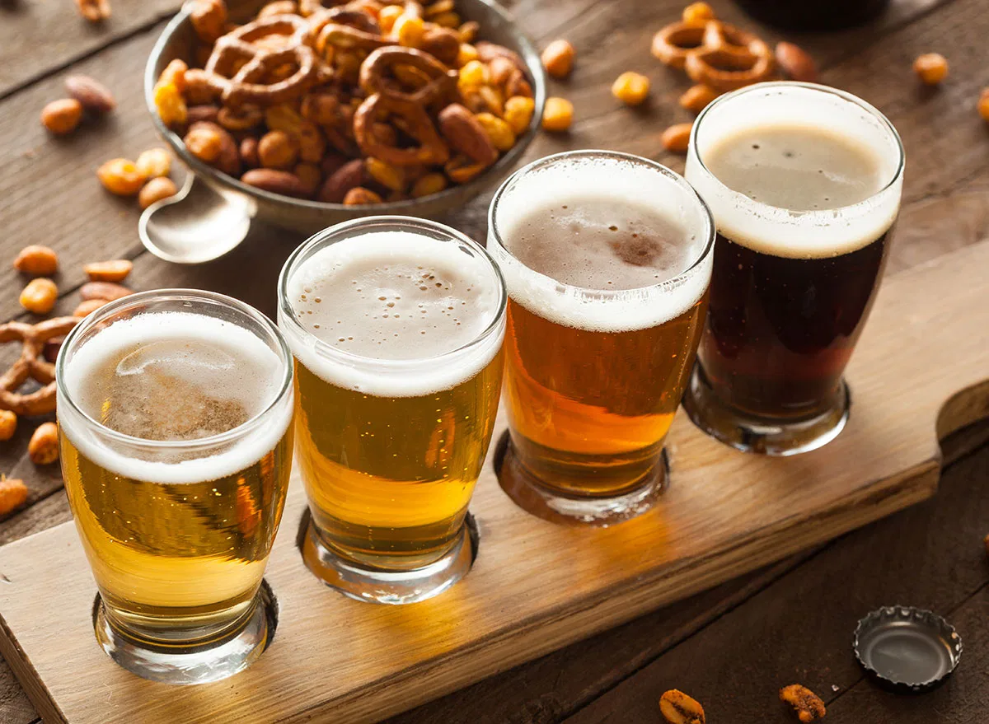
01
Goals:
Analyzing the beer market and our fidnings
Compare the differences in IBU and ABV
Make predictions and conclusions that help makes possible decisions.
02
Details:
Intepret data to suggest potential ways to improve our business in many areas

Slide 3
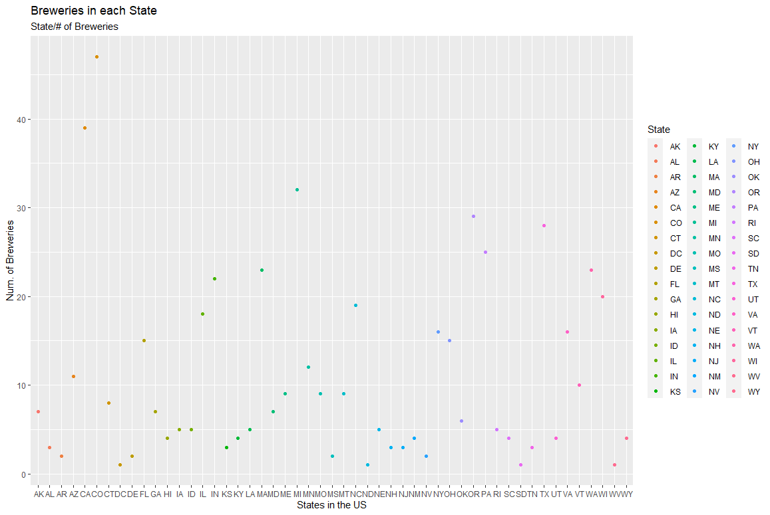

Slide 4
Top 5 States with the Most Breweries
Colorado | California | Michigan | Oregon | Texas
47 | 39 | 32 | 29 | 28
Top 5 States with the least Breweries
DC | ND | SD | WV | AR/DE/MS/NV
1 | 1 | 1 | 1 | 2
Add content here

Slide 5
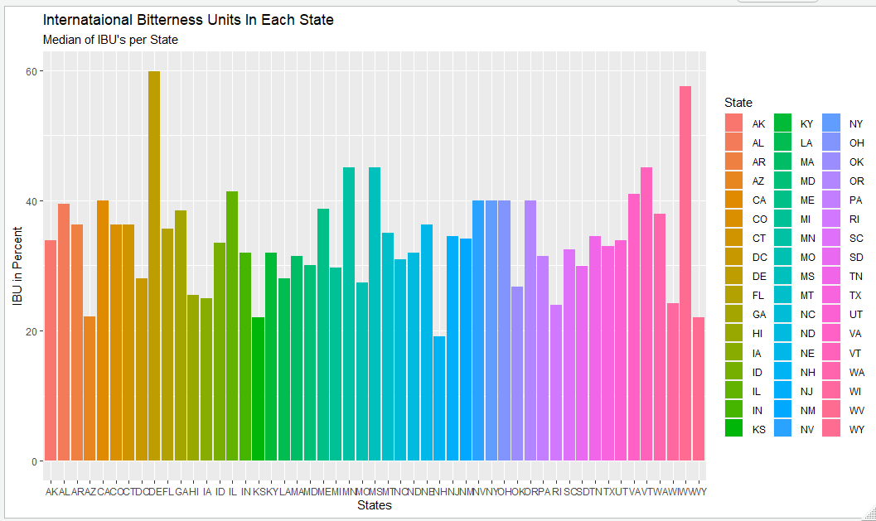
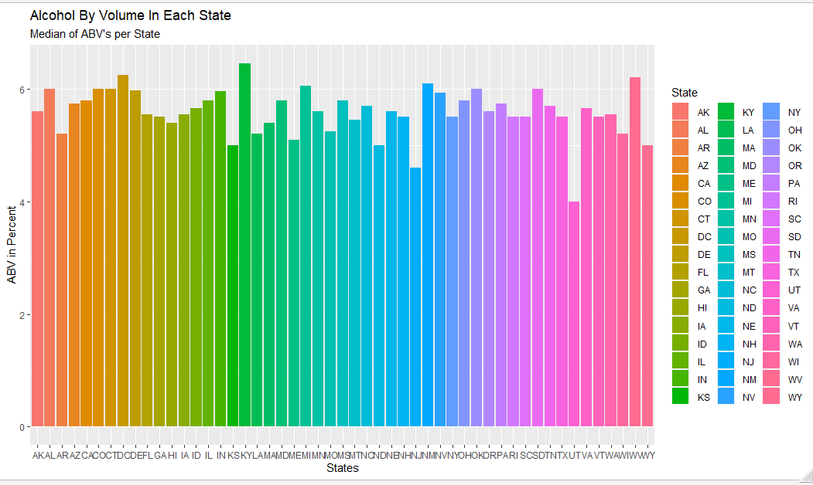
Missing Values:
ABV and IBU Details (Medians):
We found missing values in ABV and IBU column
Mean of ABV and the mean of IBU
MAX ABV: 6.4 % CO
MIN ABV: 4.0% UTAH
MAX IBU: 59.81 DE
MIN IBU: 19.10 New Hampshire
01
02
Add text
Your text has been concise and beautiful, but the information is inextricably inextricable
Add text

Slide 6
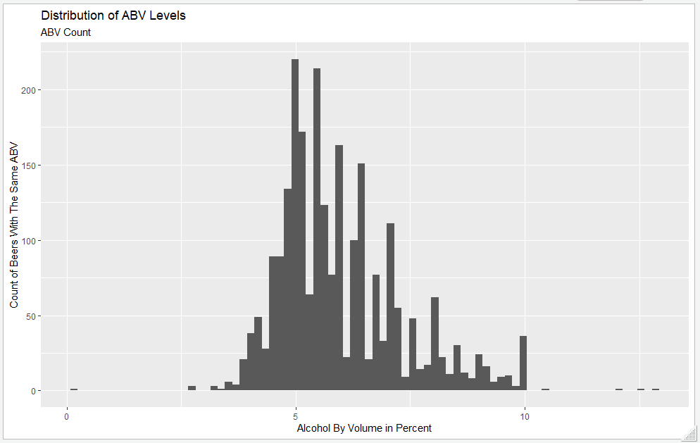
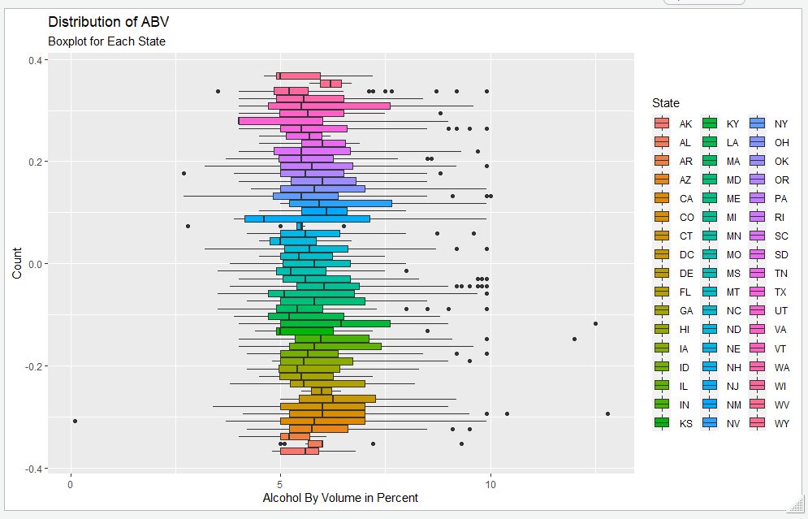
Distribution of ABV
We see that majority of the alcohol by volume of the beer falls within 5% and 6%
The data appears to be slightly right skewed.
The Average Alcohol by Volume for beers is 5.98 and the median is 5.65.

Slide 7
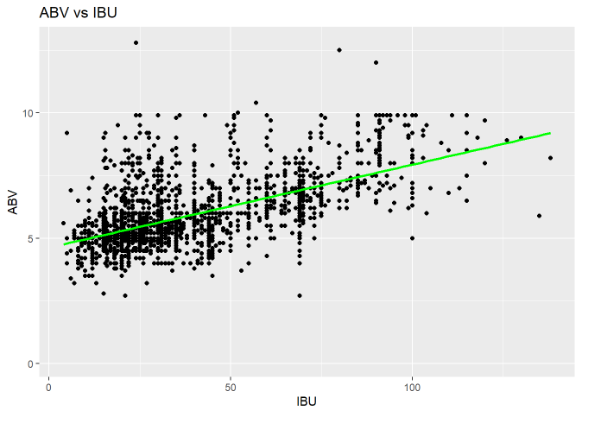
Relationship
Alcohol by Volume and IBU does have a correlation between each other.
For every increase in 1 IBU per unit the estimated ABV increases 0.003308 percent.

Slide 8
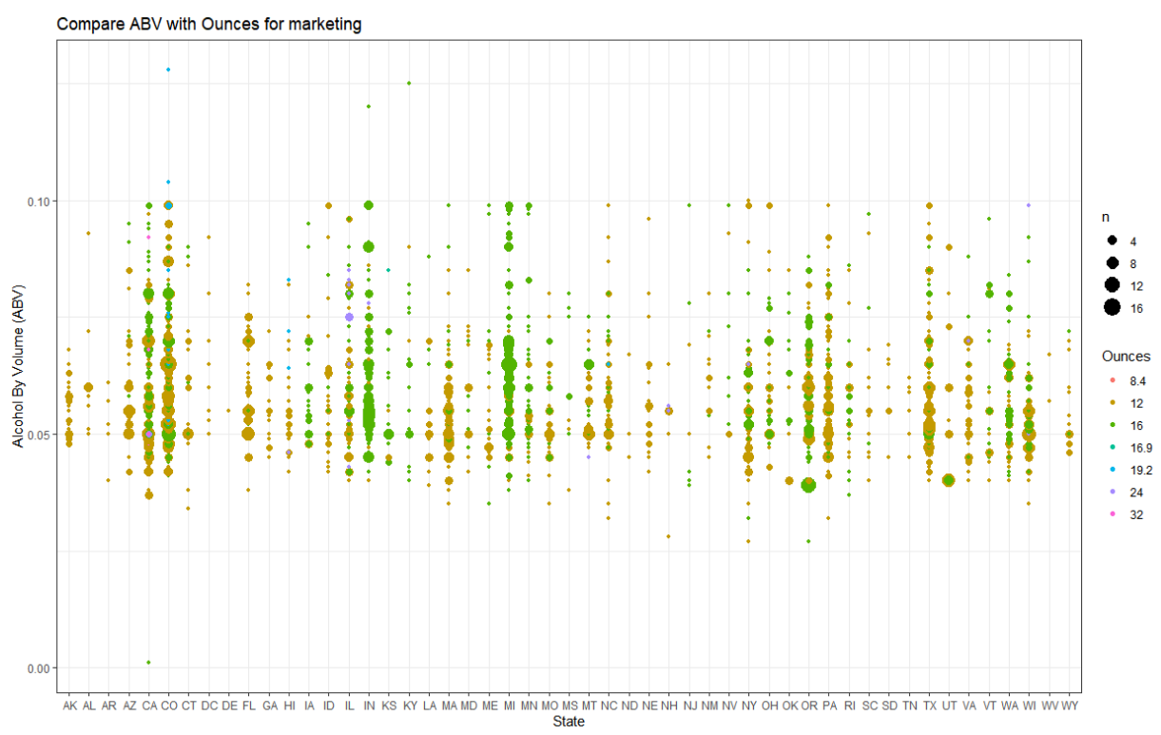
ABV And Ounces By State
Consumers based on their consumption habits and State
Most consumed beer is 12 and 16 ounces
Notes:
Create a bubble chart showing which states tend to prefer larger bottles of beer with higher ABV for marketing purposes.
# This information is useful in that it can be used to target the beer consumers based on their consumption habits ( ABV and Size of the beer) and location.
# By visualizing the Ounces of beer bottles and cross referencing this data with ABV we are able to see a pattern (we can clearly see that most of the 12 and 16 ounces).
# The pattern can then be layered over states to show which states may act as the largest consumers of beer products.
# Lighter blue circles that sit higher on the graph show high alcohol content consumption.
We can see the trend that most consumed beer is 12 and 16 ounces

Slide 9
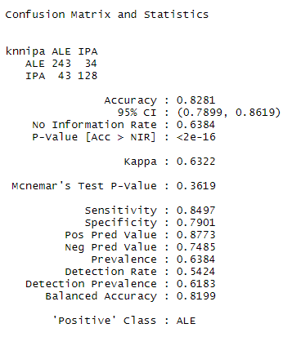
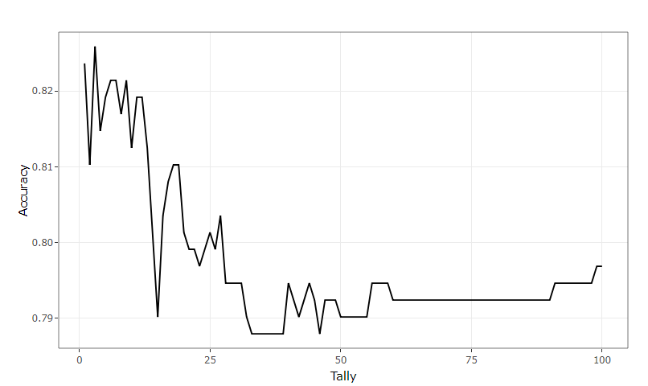
KNN Classification
Difference between IPAs (Indian Pale Ales) and Other Beers with respect to IBU and ABV
Confusion Matrix and Accuracy
KNN model predicts the outcome with an accuracy of 83%.
Optimized K value of 3
Notes:
Our KNN model predicts the outcome with an accuracy of 83% which is pretty good.
Optimized K value to 3 based upon 100 iterative run.

Slide 10
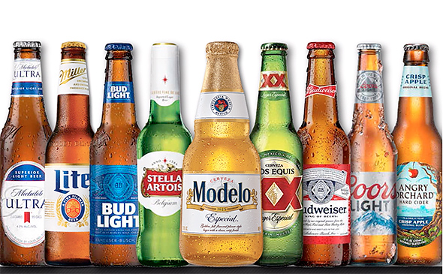
Thank you for your attention.
Add text

